Slide 1
Robot Design
Team: @Rising Stars
Team No : 66782
Lego League 2024
Theme: Submerged
f
Notes:
Ria

Slide 2
Team Members
Name Age
Riya Patil 11
Zoey Jain 10
Shaivi Aggarwal 10
Saanvi Loomba 10
Riona Panda 9
Saumya Loomba 10
Notes:
Riya
Good Morning Judges, We are

Slide 3
Mission Strategy
First year for Challenge and new to programming.
Tried missions with hand and picked ones we thought we can manage.
Took mission board print out and marked on those sheets to find missions and path required.
Tried various combinations to maximize score.
Notes:
Zoey

Slide 4
Resources Used
Spike Prime Lessons
Online FLL Tutorials
Online research
Team Coaches
Talked to other team coach
Lego robot design and team guides
Notes:
Zoey

Slide 5
Skill building
Did basic programs to move straight, turn, use sensors and motors
Created Pseudo code with paper and pencils
Shared and improved
Distributed work in two groups to get things done faster
Planned rough design for attachments needed
Created reusable code blocks for different missions
Notes:
Shaivi

Slide 6
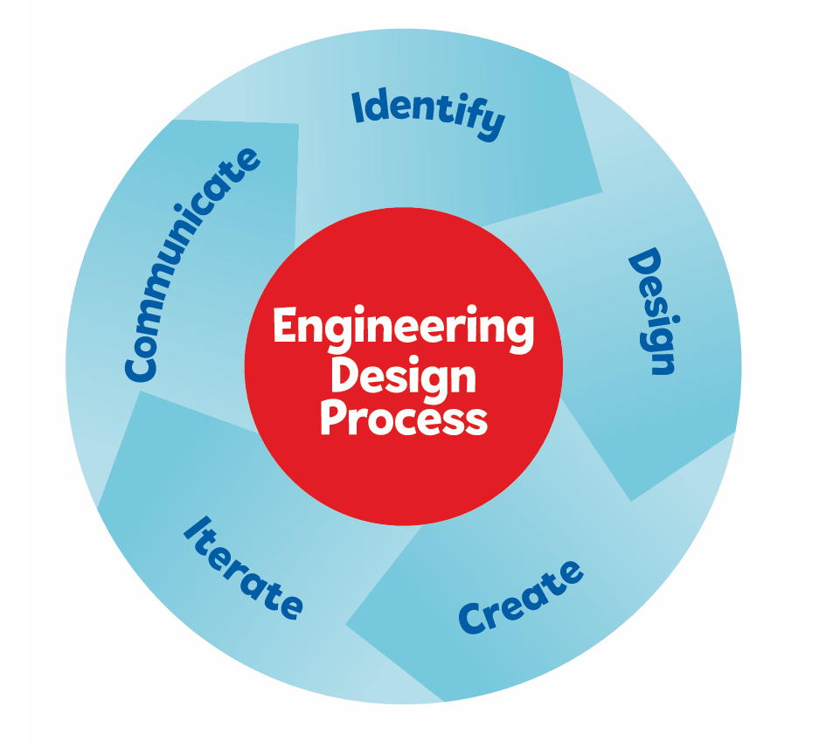
Engineering Design Process
Notes:
Shaivi

Slide 7
Robot Design
New team so we started with instructions for Advanced Driving Base.
Tried another online design.
Used Engineering Design process to iterate and improve.
Combined features from the earlier designs to create final version our Little Bot.
Tried many runs to improve with different front and rear attachments.
Notes:
Saanvi

Slide 8
Robot Design
4 Motors
2 for Wheels
1 for Front and 1 for Rear attachments
2 large wheels to make it fast
2 coaster wheels to support big wheels
1 flat surface and 1 or more place to add attachments
Charge port accessible
Color sensors
Easy to connect and remove attachments
Notes:
Saanvi

Slide 9
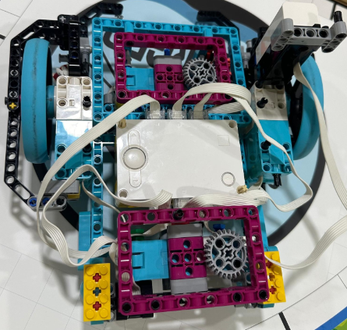
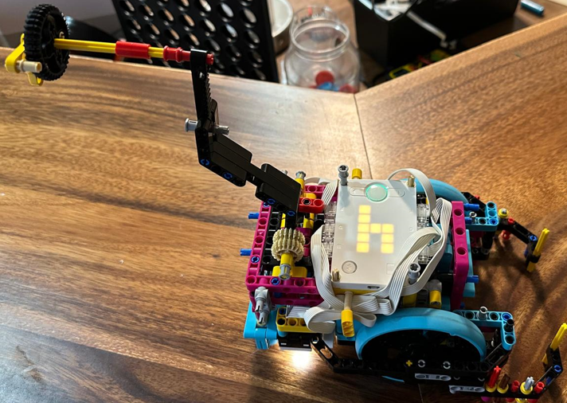
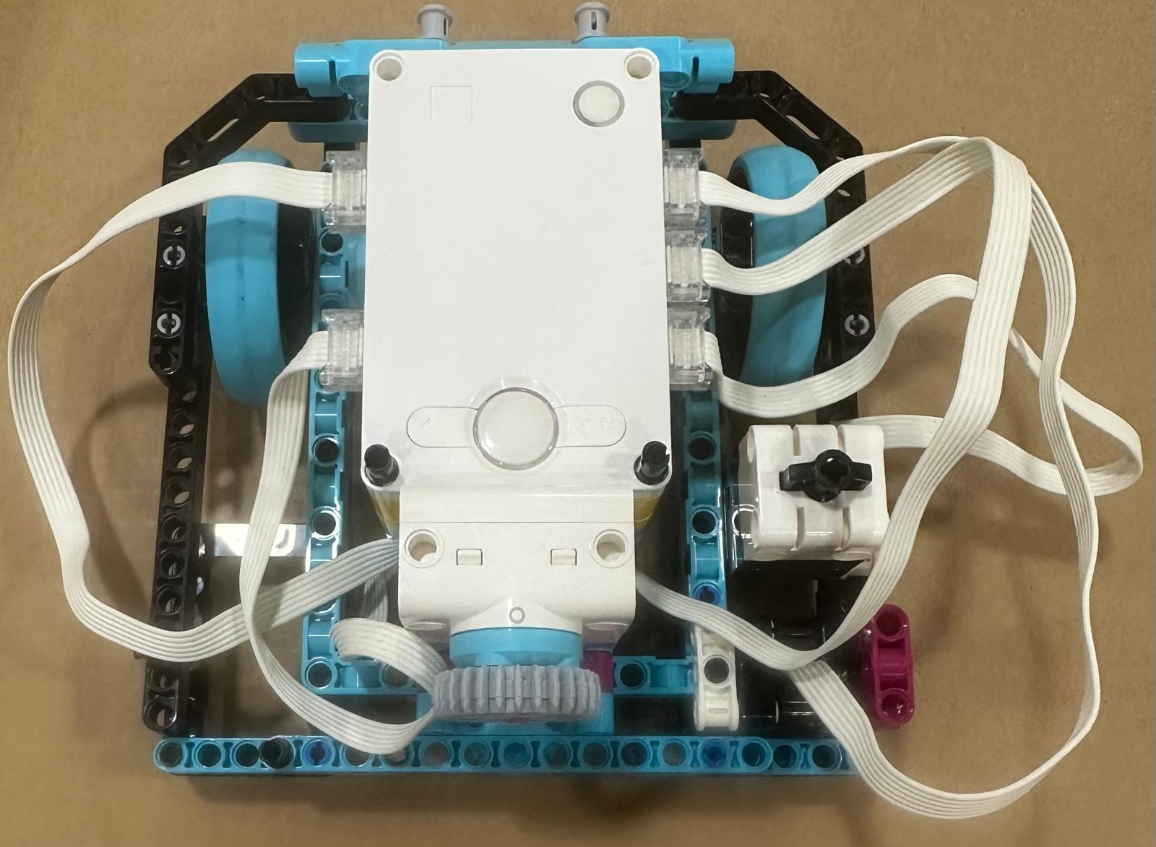
Iterate and learn
We combined features from first 2 designs to create our final design which is compact
Notes:
Riona

Slide 10
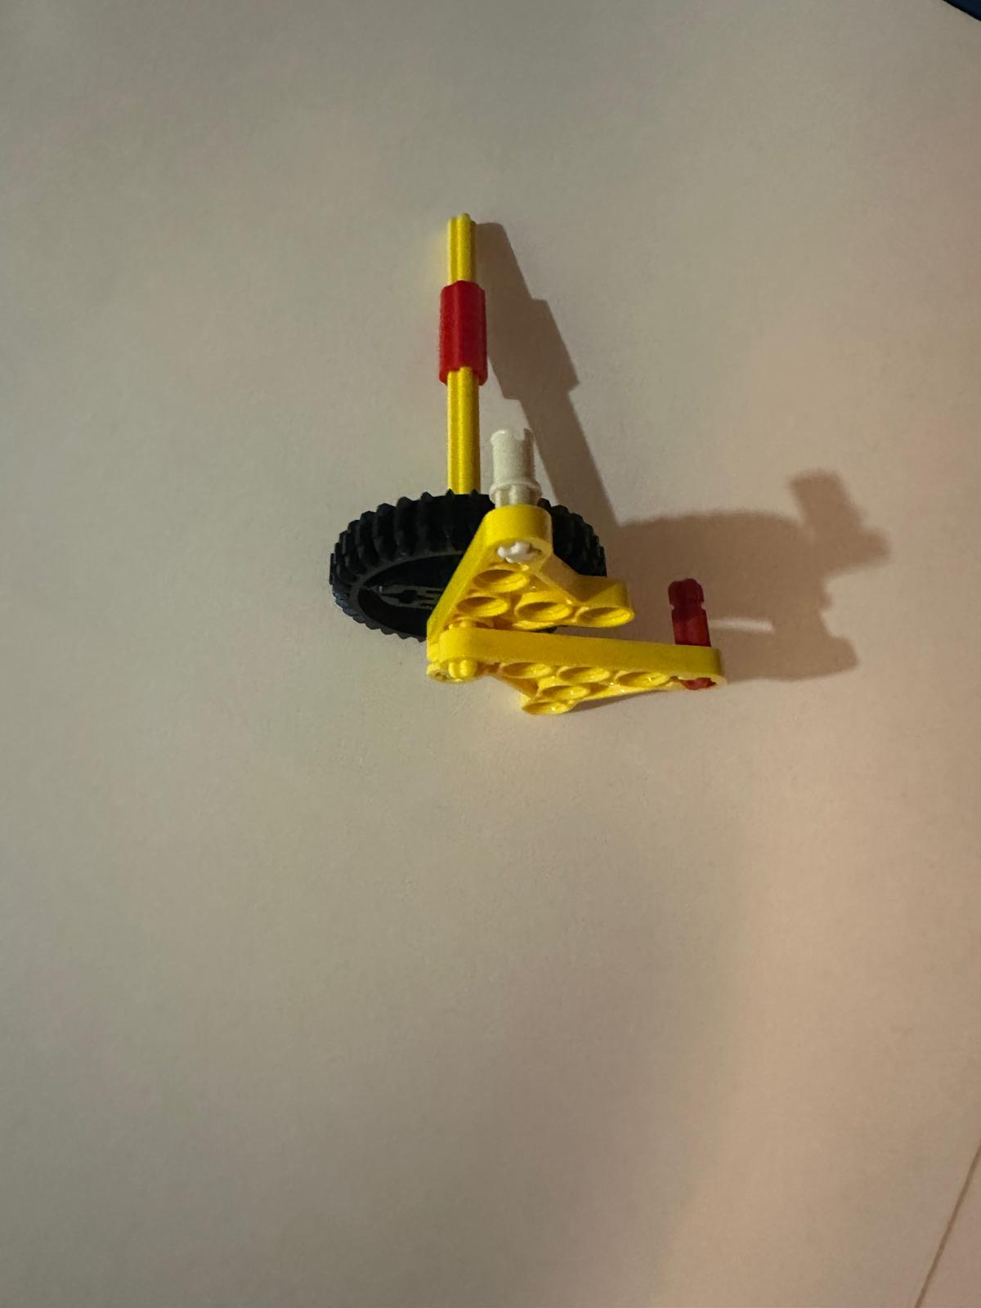
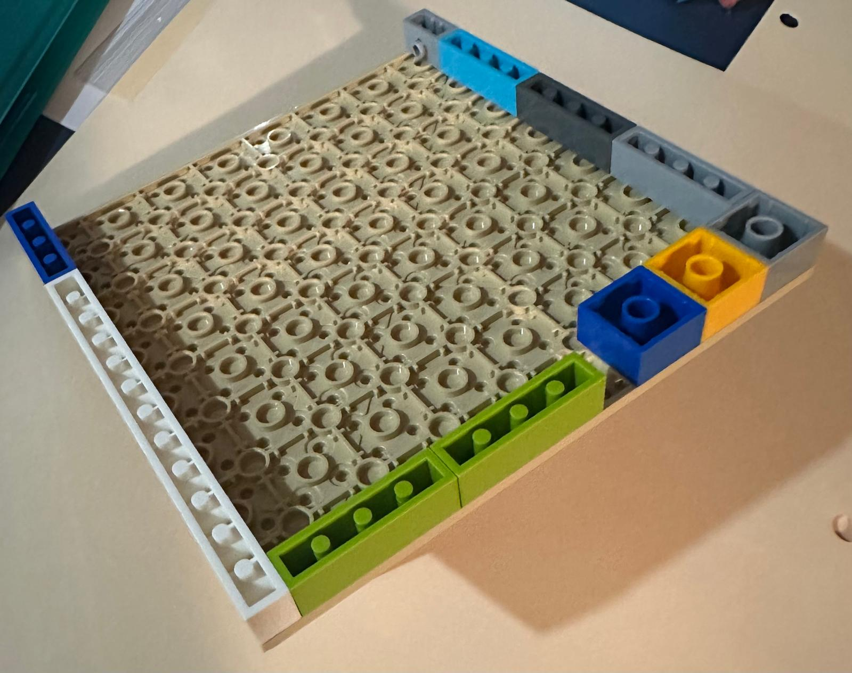
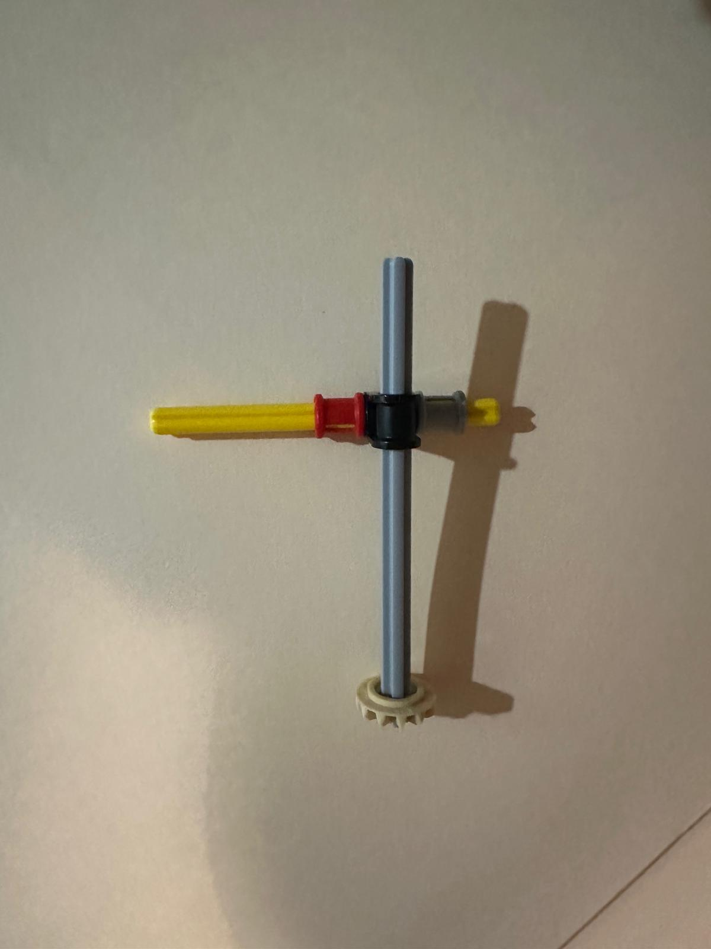
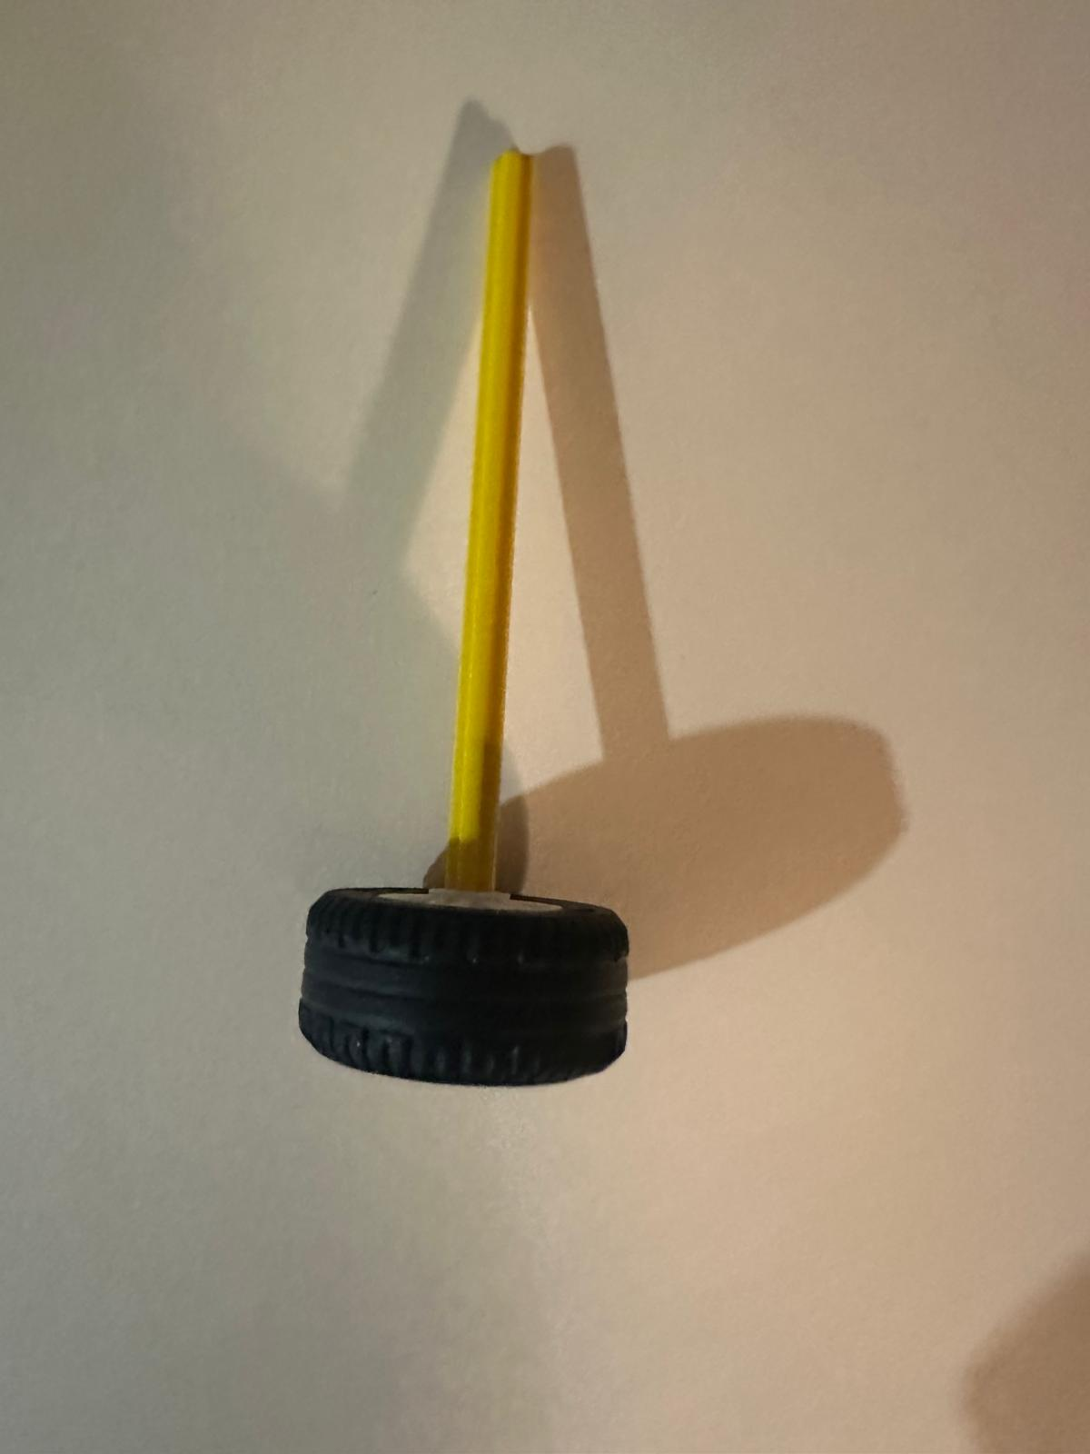
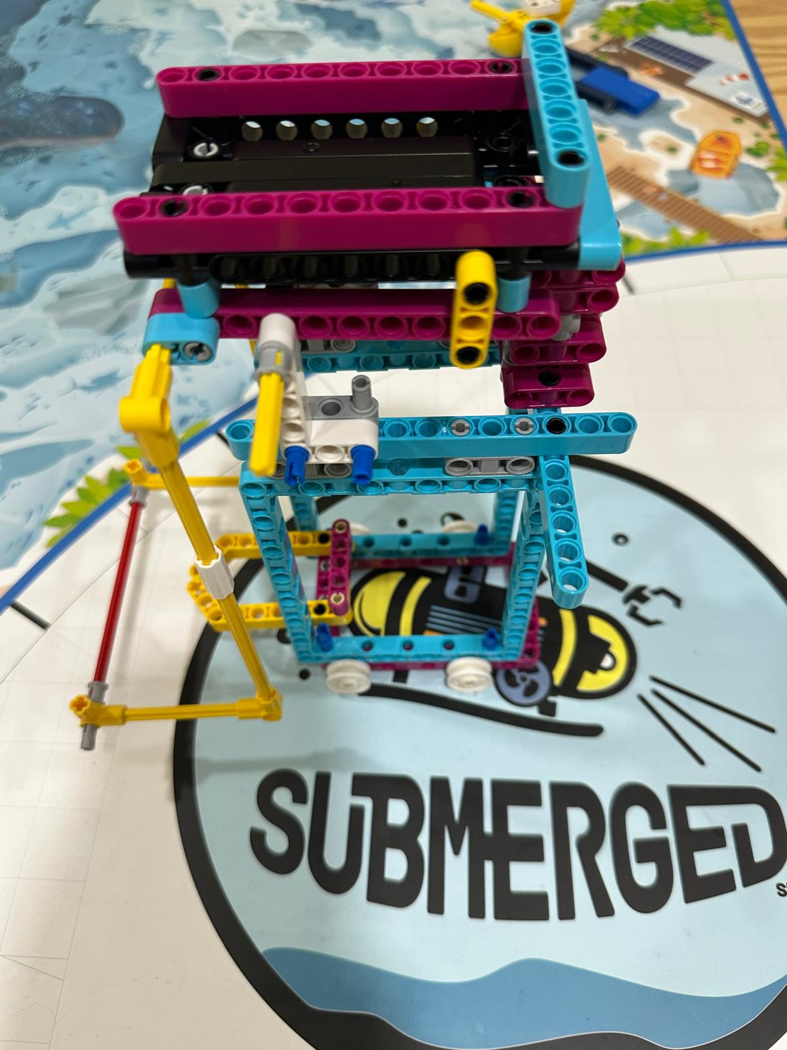
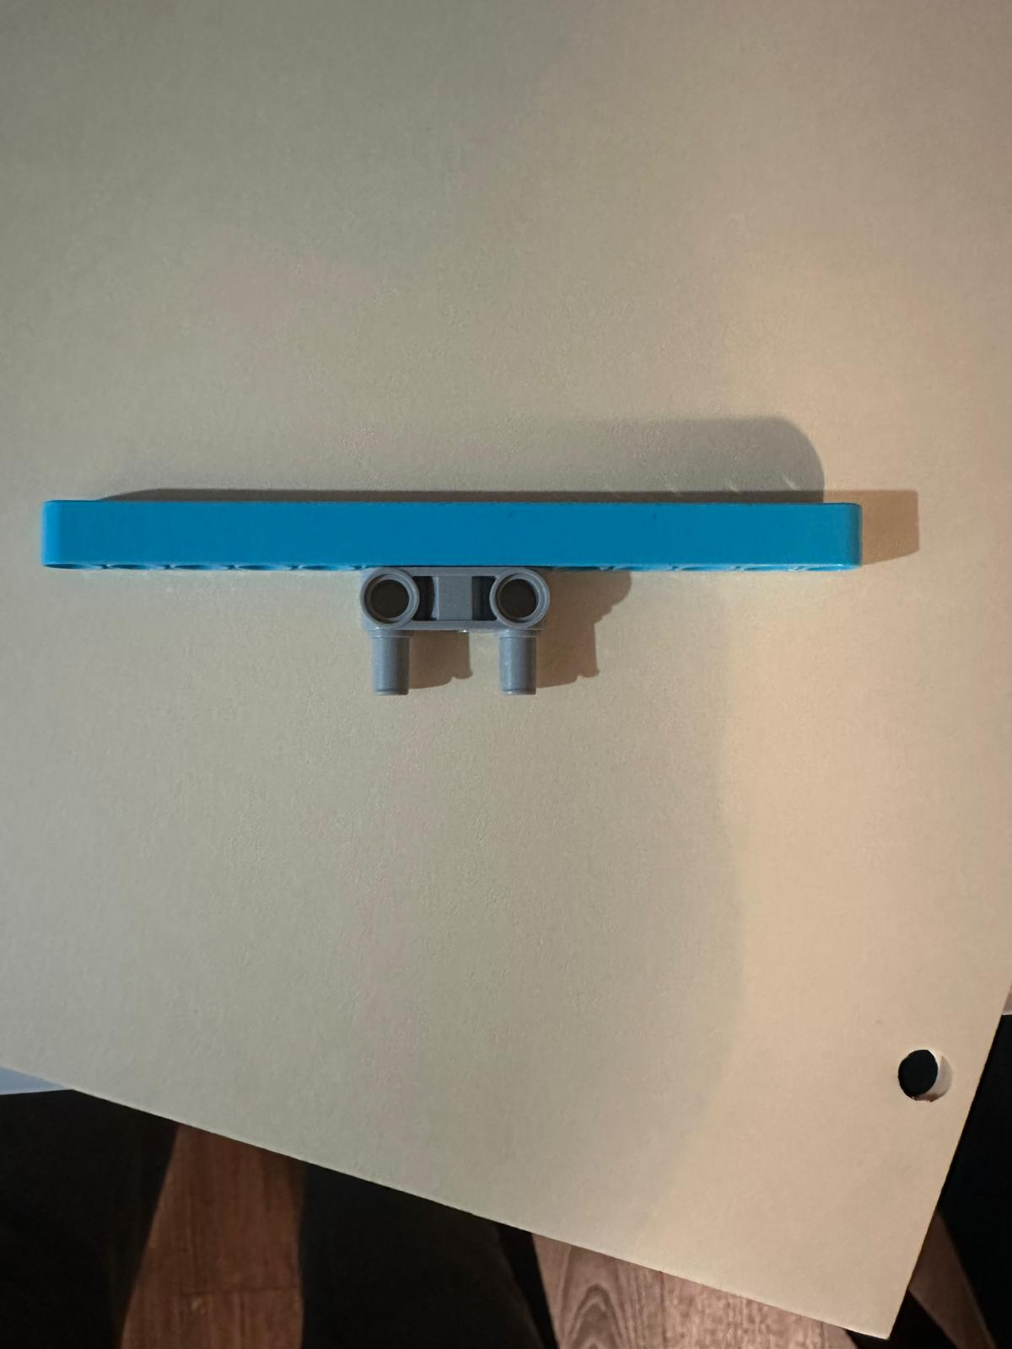
Used learning to Improve
It’s easy to add attachments on front and back of our compact little Bot Robot.
We also made several simple attachments for missions
Notes:
Riona

Slide 11
Share and Enjoy
We took turns and shared workload and experience.
Team had 6 girls and we became good friends and had lot of fun during break time.
At times robot did not work as programmed and broke models and seeing it fail was funny.
We had so much fun during field trip at USS Cod submarine on a freezing cold day.
We discovered new and creative ways to solve missions and really enjoyed it.
Notes:
Saumya

Slide 12
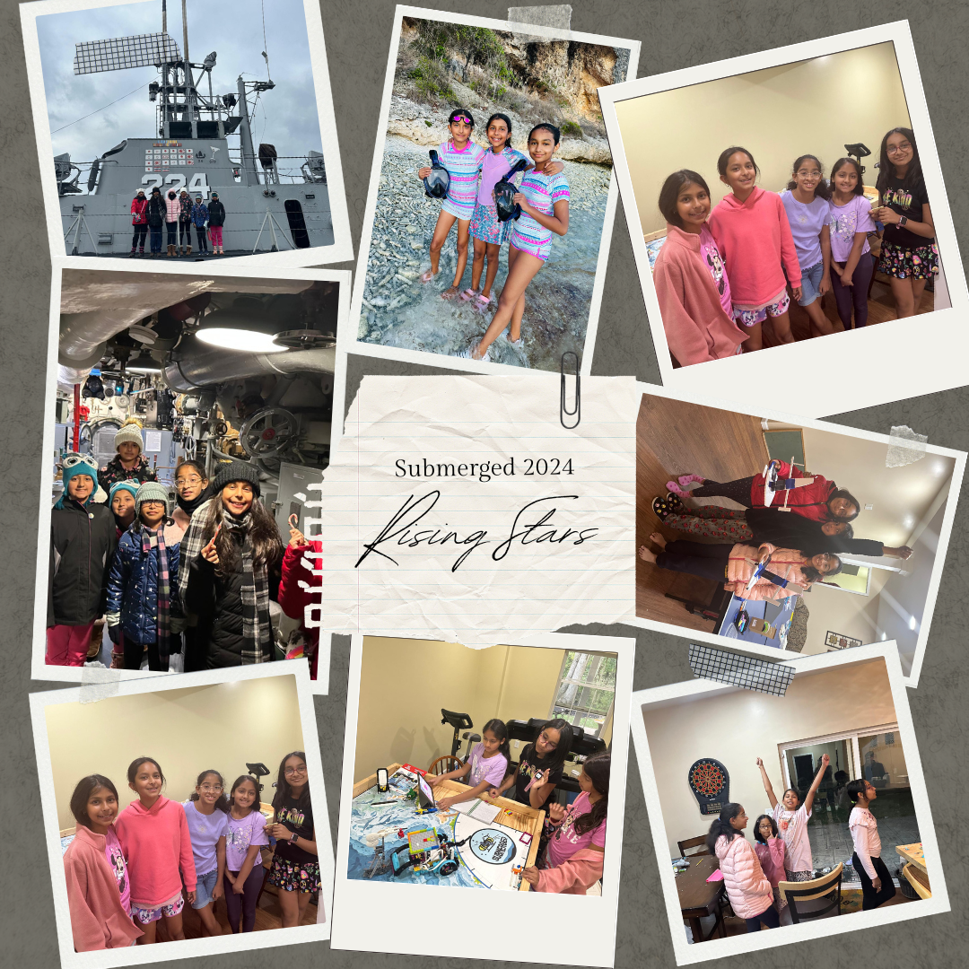
Notes:
Saumya
Here are some pictures we captured during our season with some fun moments

